Slide 1
Navigating the Path to Mastery
Programming for Practical Skill Development
Dr. Charles Severance
University of Michigan School of Information

Slide 2
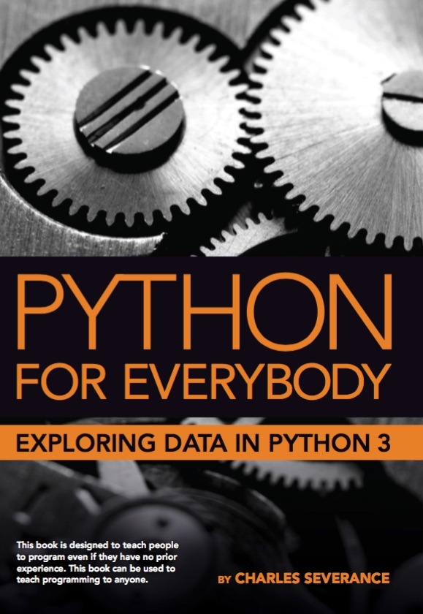
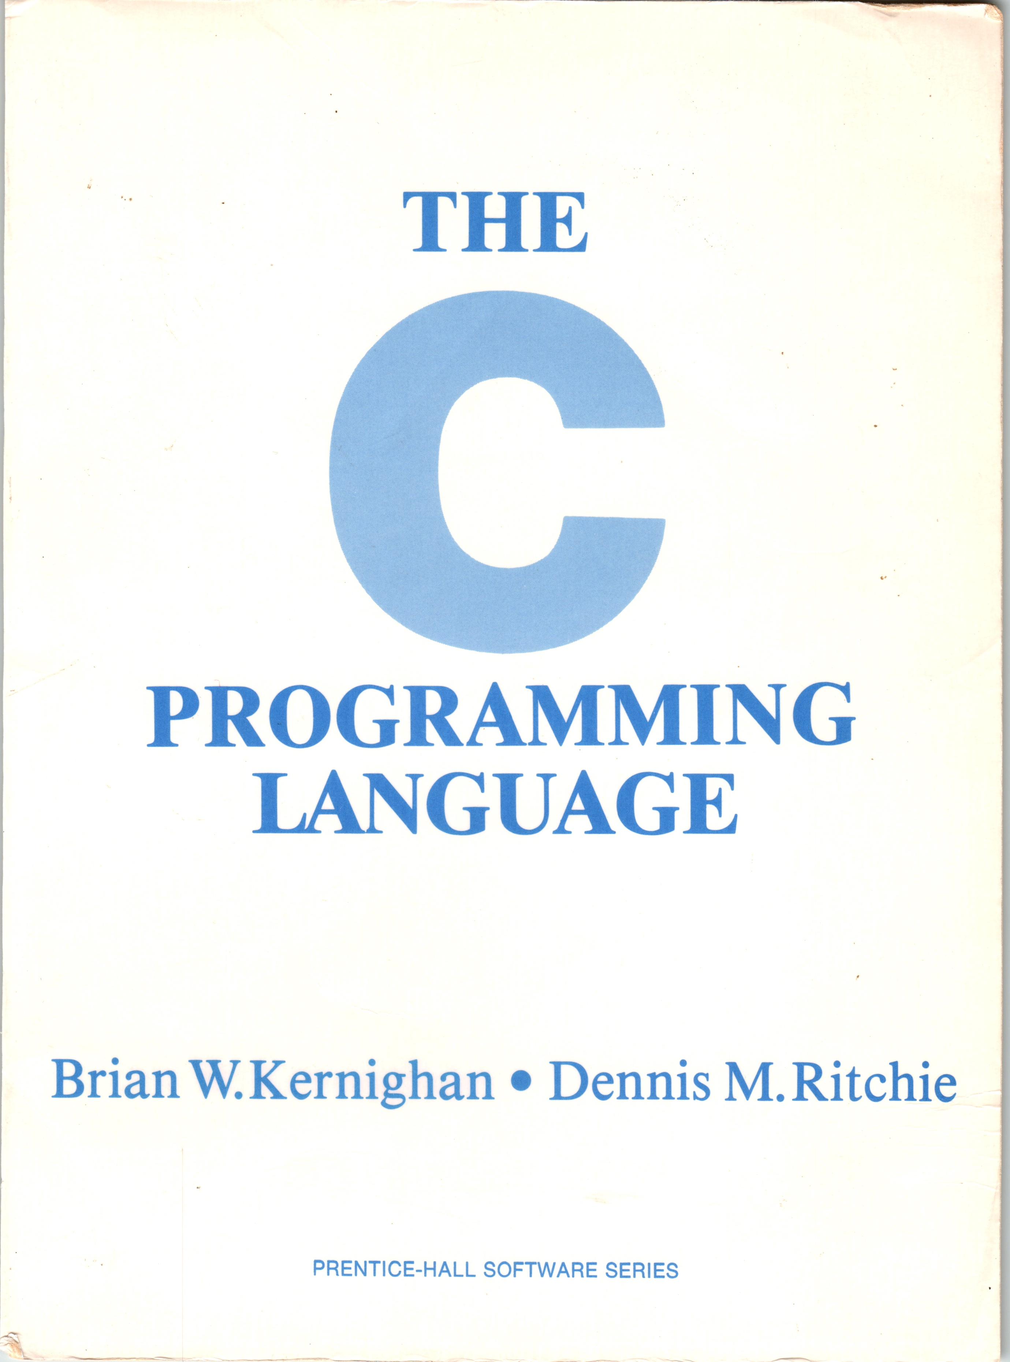
A Tale of Two Books, 10 years, and Coursera
Coursera: Python for Everybody (2013)
Coursera: C Programming for Everybody (2023)

Slide 3
Coursera: Python for Everybody
Introduced in 2013, Updated 2016, 2024
The most popular programming course in the world
Translated into 10+ Languages
In browser development environment
Many auto-graded exercises
Extra – more than just a course
Interviews
Office Hours

Slide 4
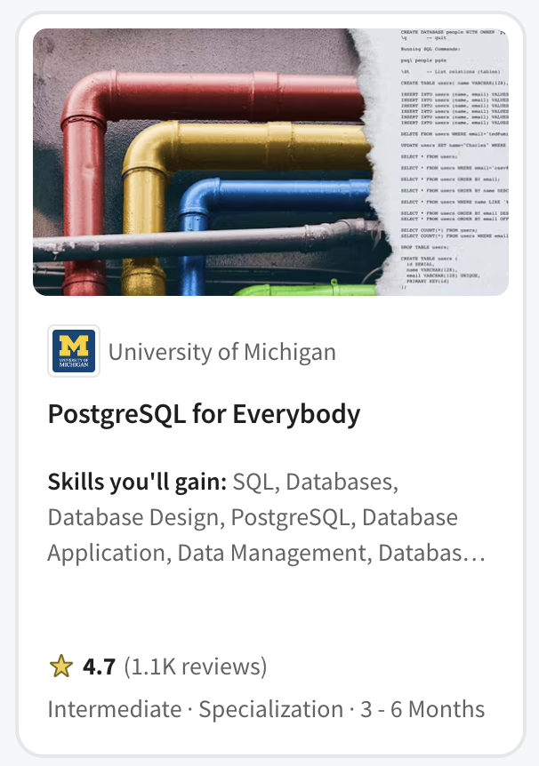
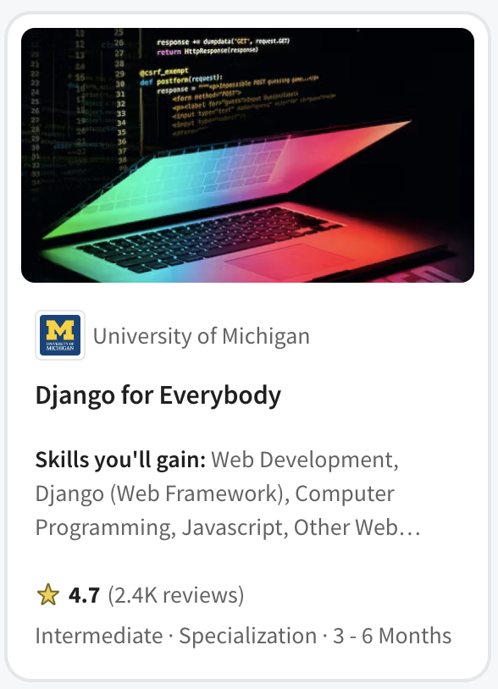
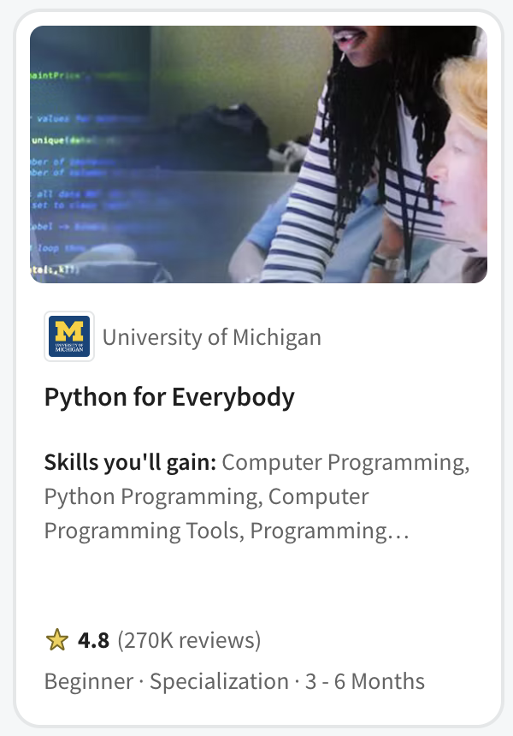
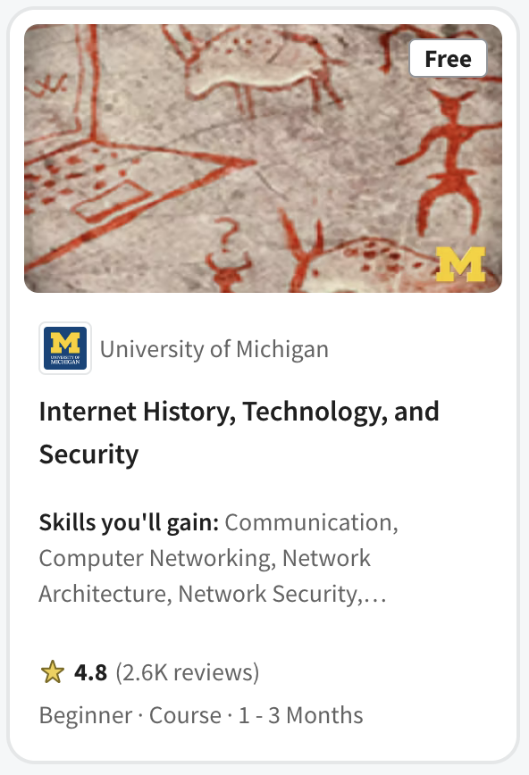
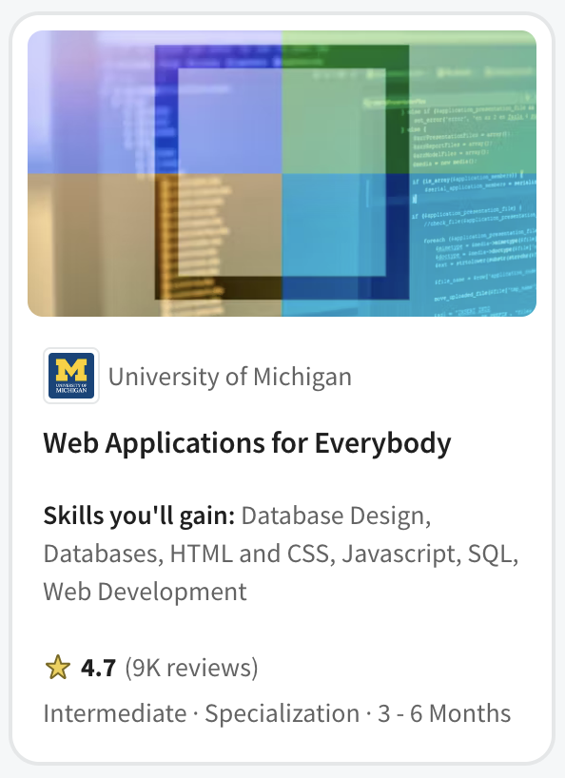

Slide 5

Every week 1400 new students enroll in Python for Everybody in India

Slide 6

Introductory Programming
Master Programmers

Slide 7

Who would I hire?
I have met many amazing developers
Not the most educated
Not the most brilliant minds
Learned through working on large complex projects
Love to help other people learn

Slide 8
It is not what they know…
Flask
SpringMVC
RedShift
BigData
Rust
Java
C#
Scala
JavaScript
HTML
Go
C++
VB
Fortran
AI
Kotlin
Node
PHP
C
React
JQuery
Perl
Dart
Backbone
Angular
R
ObjectiveC
Svelte
Lua
Ruby
COBOL
Django
SQL
Assembly
Swift
Python
Jupyter

Slide 9

It is how they learn
Can learn any programming situation and master it in four weeks
See past the syntax (X-ray Vision)
Run-time environments and internal data structures memory use, performance tradeoff

Slide 10

Unlocking a deeper understanding of Python by teaching C

Slide 11
My goals for students (not the course outline)
Understand C through a Python lens and Python through a C lens
Understand the nature of object-oriented programming
Understand interfaces
Different implementations behind an abstraction
Explain the how Python was built in C and inspired by C++
Have a sense of how the Python run time manages its objects and uses memory
See historical connections between C, C++, Python, Java, and JavaScript

Slide 12
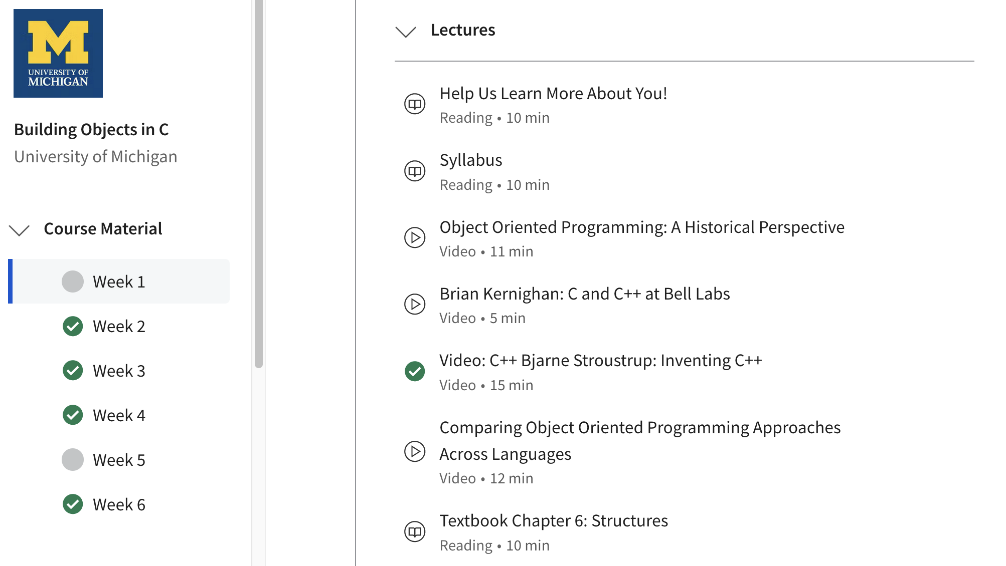

Slide 13


C Programming for Everybody
Uses 1978 edition of book to focus on historical impact of C
Online textbook with executable examples
Accessible audio book including code samples
Starts by comparing Python to C (Rosetta Stone)
48 Auto-graded assignments
Brower-based development and compiler environment
Ends with building Python objects in C
Extras
Interviews: Brian Kernighan, Bjarne Stroustrup, Guido van Rossum

Slide 14
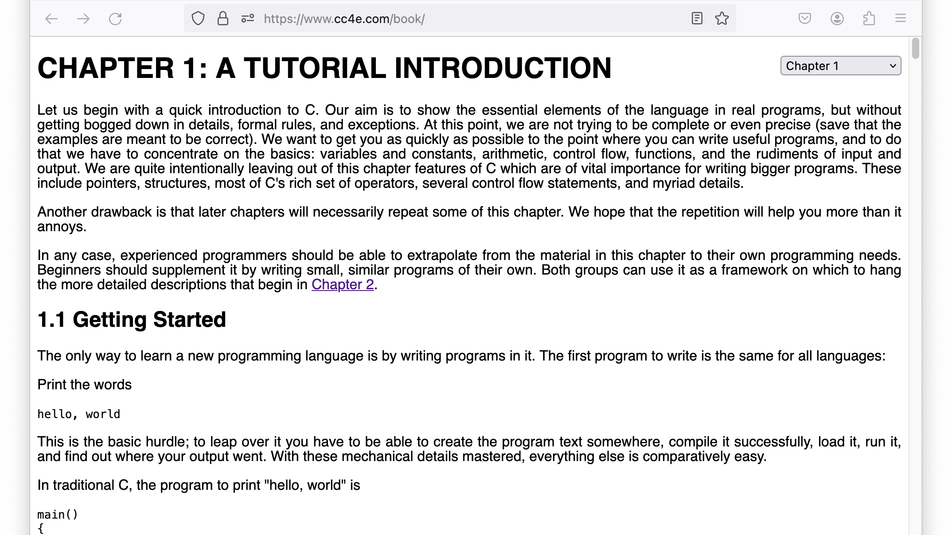

Slide 15
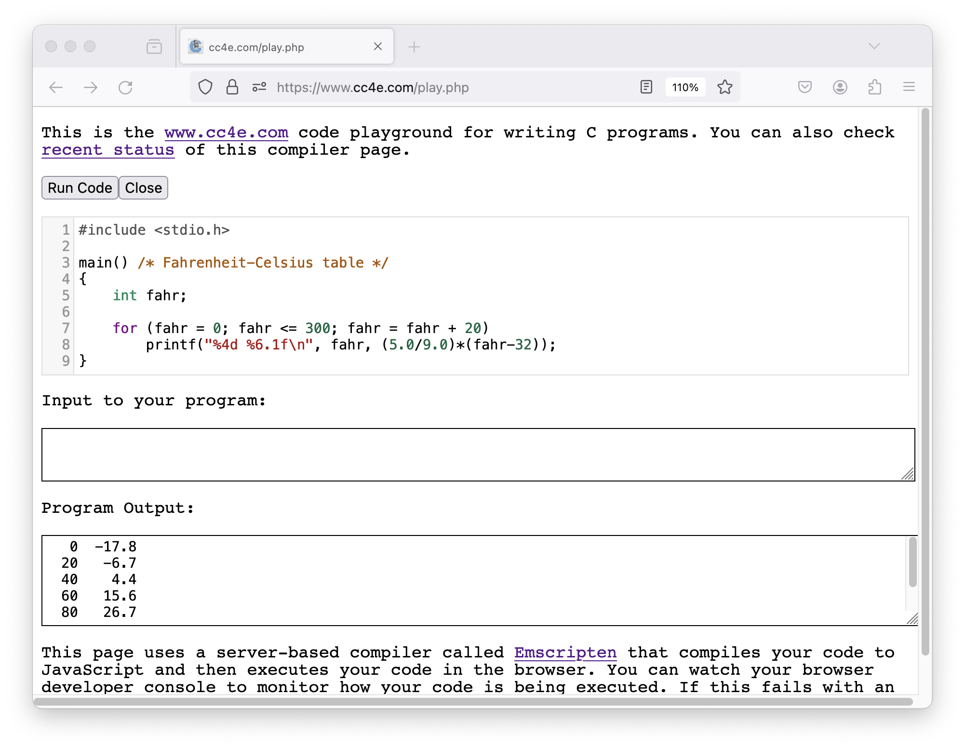

Slide 16
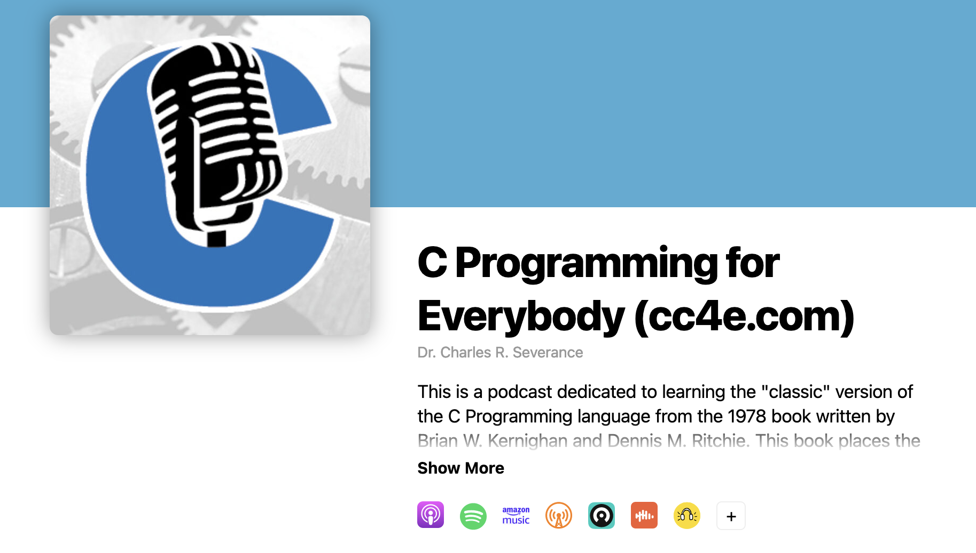
https://audio.cc4e.com

Slide 17
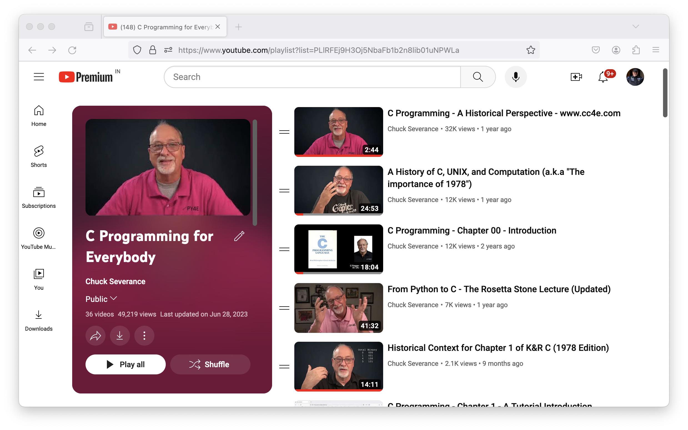
https://video.cc4e.com

Slide 18
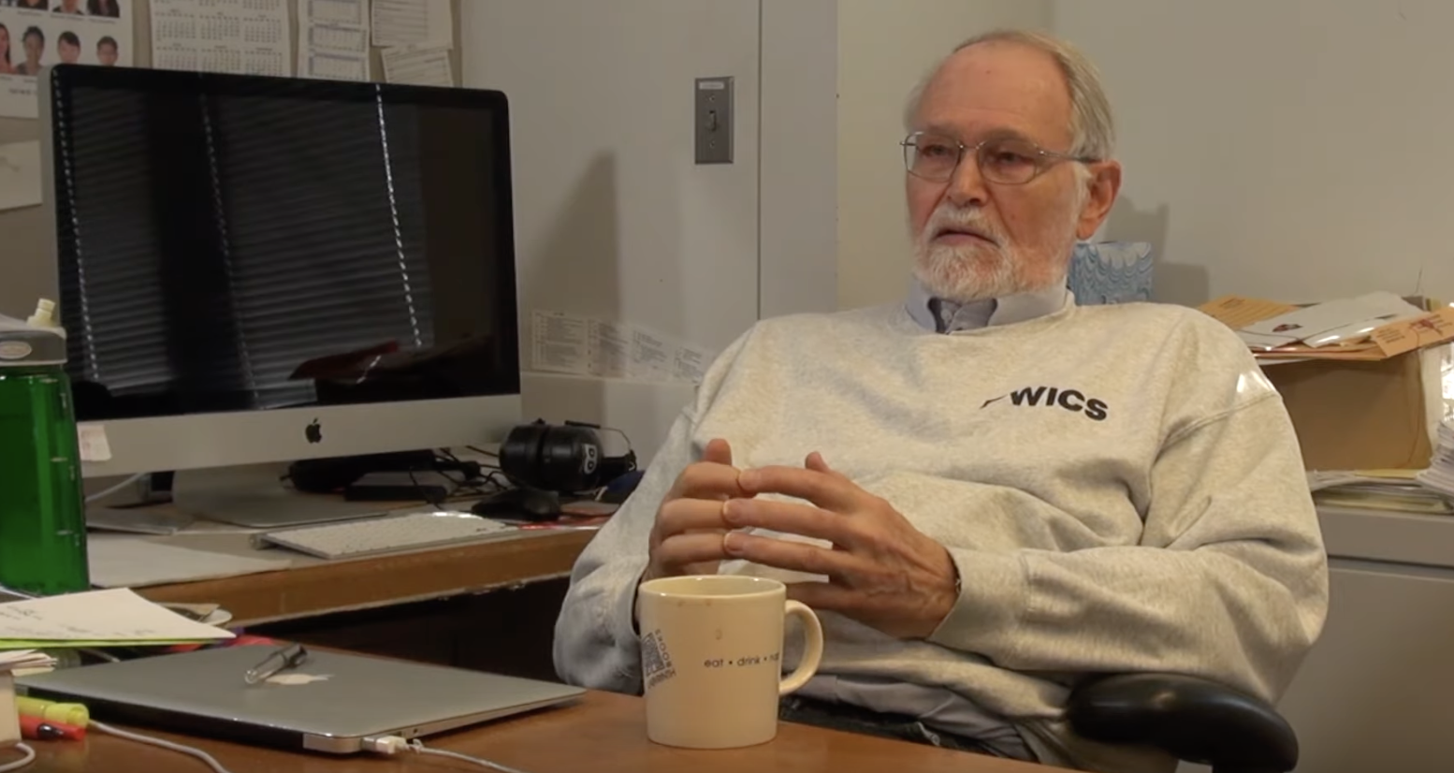
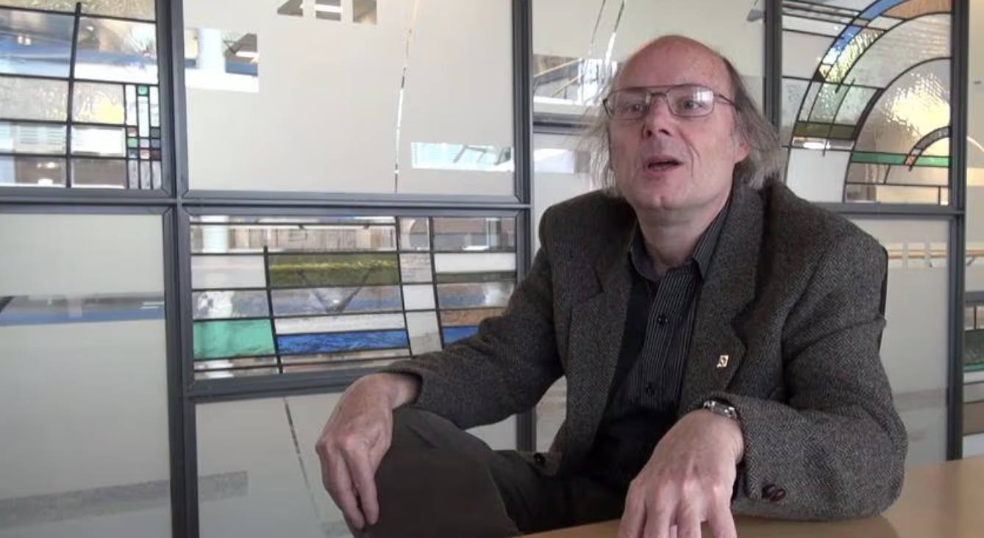
Brian
Kernighan
Bjarne
Stroustrup

Slide 19
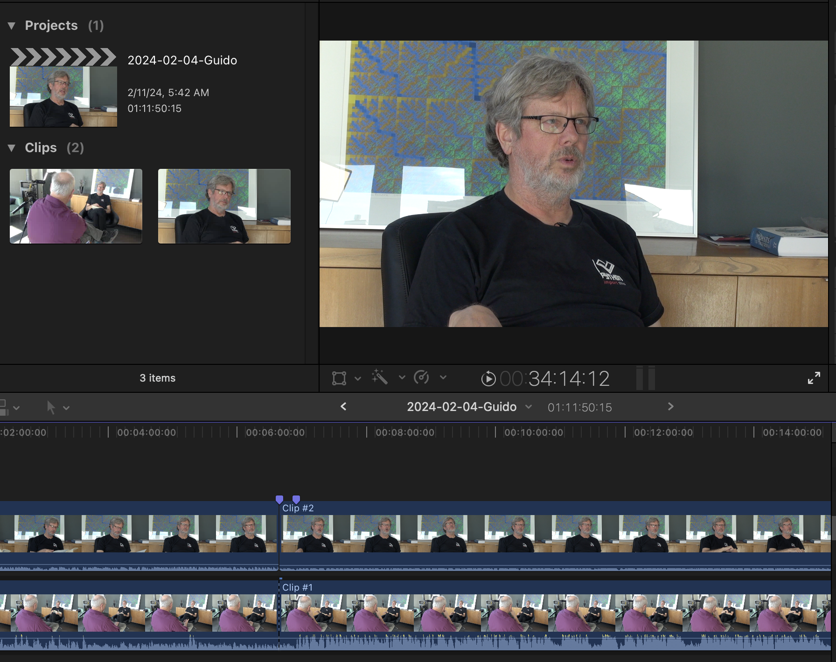
Guido
van
Rossum

Slide 20
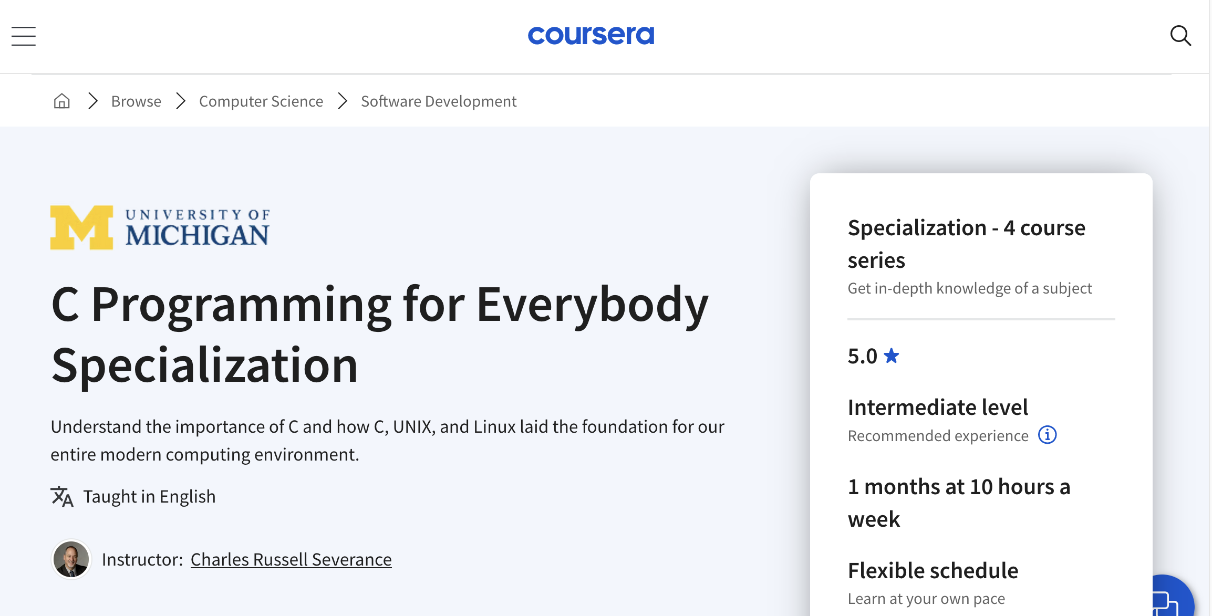

Slide 21

After C: Computer Architecture

Slide 22
My goals for students (not the course outline)
What is an "electronic computer"?
What is a gate?
What is inside of a chip?
How do CPUs work?
What is machine language?
What is an assembler?
What is a compiler?

Slide 23

Navigating the Path to Mastery
It is not about learning everything
It is about preparing to learn anything

